Slide 1




C#: ASP.NET MVC Overview
Models with Entity Framework, Views with Razor, Controllers
C# Web
ASP.NET
SoftUni Team
Technical Trainers
Software University
http://softuni.bg

Slide 2

Table of Contents
Object-Relational Mapping (ORM)
ORM and Entity Framework
Creating a Database Context
CRUD Operations with EF
ASP.NET MVC
Controllers, Handling Forms
GET, POST Methods
Razor View Engine
Syntax, Variables, Conditions, Loops

Slide 3
Have a Question?
sli.do #tech-softuni

Slide 4
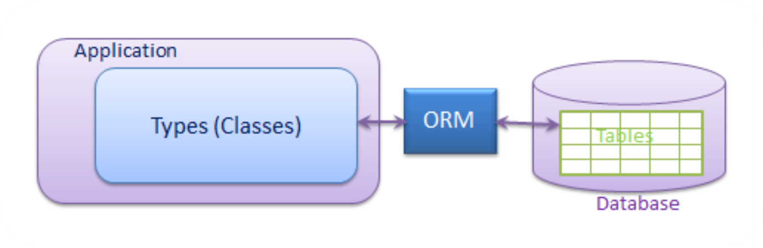
Object-Relational Mapping (ORM)
ORM Concepts and Features

Slide 5
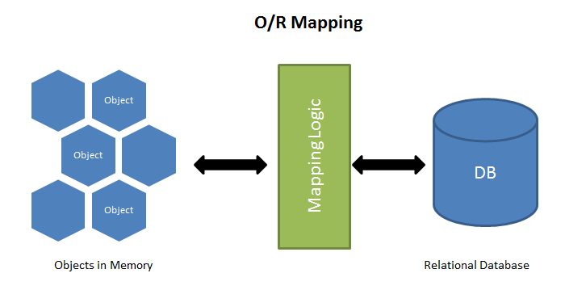
ORM Frameworks – Overview
ORM Frameworks map OOP classes to database tables

Slide 6
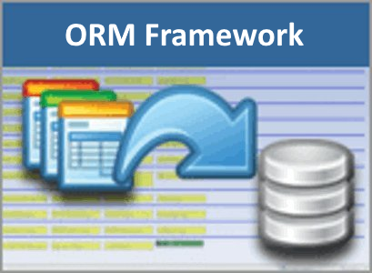
ORM Frameworks – Features
C# / Java / PHP classes are mapped to DB tables
DB relationships are mapped to class associations
ORM provides API for CRUD operations
List objects / query database
Create new object
Update existing object
Delete existing object
ORM provides schema synchronization (DB migrations)
CRUD operations execute
SQL commands in the DB

Slide 7

Entity Framework (EF)
Powerful ORM for .NET and ASP.NET MVC

Slide 8
Entity Framework – Overview
Entity Framework (EF) is modern ORM Framework for C# / .NET
Access database through DbContext with C# classes:
class BlogDbContext : DbContext
{
public DbSet<User> Users { get; set; }
public DbSet<Article> Articles { get; set; }
}
class User { Id, Username, PasswordHash, FullName, Articles }
class Article { Id, Title, Content, Date, AuthorId, Author }
var db = new BlogDbContext();
foreach (var a in db.Articles)
Console.WriteLine(a.Title + " " + a.Date);

Slide 9
C# Attributes
C# uses strongly-typed attributes
Syntax highlighting + error checking
Example – simple authorization using attributes:
[Attribute] annotates the code below it
[Required]
public String Email { get; set; }
[Authorize(Roles = "Administrator")]
public ActionResult АdminPanel()
{
…
}
Role-based authorization

Slide 10
Creating Models (Entity Classes) with EF
EF uses classic C# classes (POCO) with attributes:
public class User
{
public int Id { get; set; }
[Required]
public string Username { get; set; }
public string PasswordHash { get; set; }
public string FullName { get; set; }
public List<Article> Articles { get; set; }
}
The Id column is the primary key
[Required] makes the DB column non-nullable
One-to-many relationship
More info: http://www.nakov.com/blog/2015/05/29/entity-framework-ef-orm-for-beginners/

Slide 11
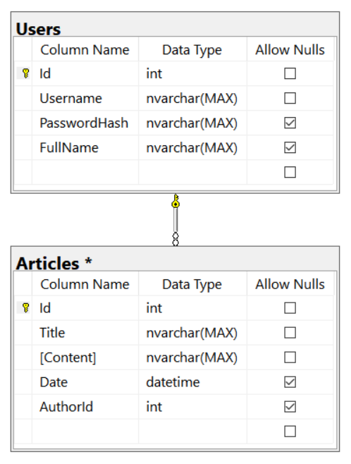
Creating Models (Entity Classes) with EF (2)
public class Article
{
public int Id { get; set; }
[Required]
public string Title { get; set; }
[Required]
public string Content { get; set; }
public DateTime? Date { get; set; }
public int? AuthorId { get; set; }
public User Author { get; set; }
}
Many-to-one relationship

Slide 12
Creating the DbContext Class
Creating a DB context for the application:
User and Article entities (model classes)
using MVCApplication.Models;
public class AppDbContext : DbContext
{
public DbSet<User> Users { get; set; }
public DbSet<Article> Articles { get; set; }
}
List the mapped DB tables using DbSet<Type>

Slide 13
DbContext: Accessing Table Data
Use DbContext class for accessing the database
Access through properties, instead of database queries
var db = new AppDbContext();
foreach (var a in db.Articles)
{
Console.WriteLine($"Title: {a.Title}");
Console.WriteLine($"Content: {a.Content}");
Console.WriteLine($"Posted by: {a.Author?.FullName}");
}

Slide 14

ASP.NET MVC Overview
ASP.NET MVC, Razor, Entity Framework

Slide 15
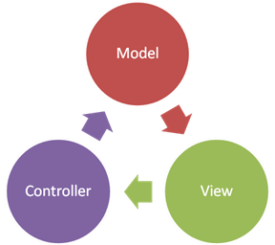
ASP.NET MVC Overview
Open Source Web Application MVC framework
Developed by Microsoft
Code and markup are separated
Based on .NET Framework / .NET Core
Develop Web apps using C# and use all of its features and .NET APIs
Often combined with Entity Framework for ORM
Typically uses Razor as a view engine (templating engine)

Slide 16
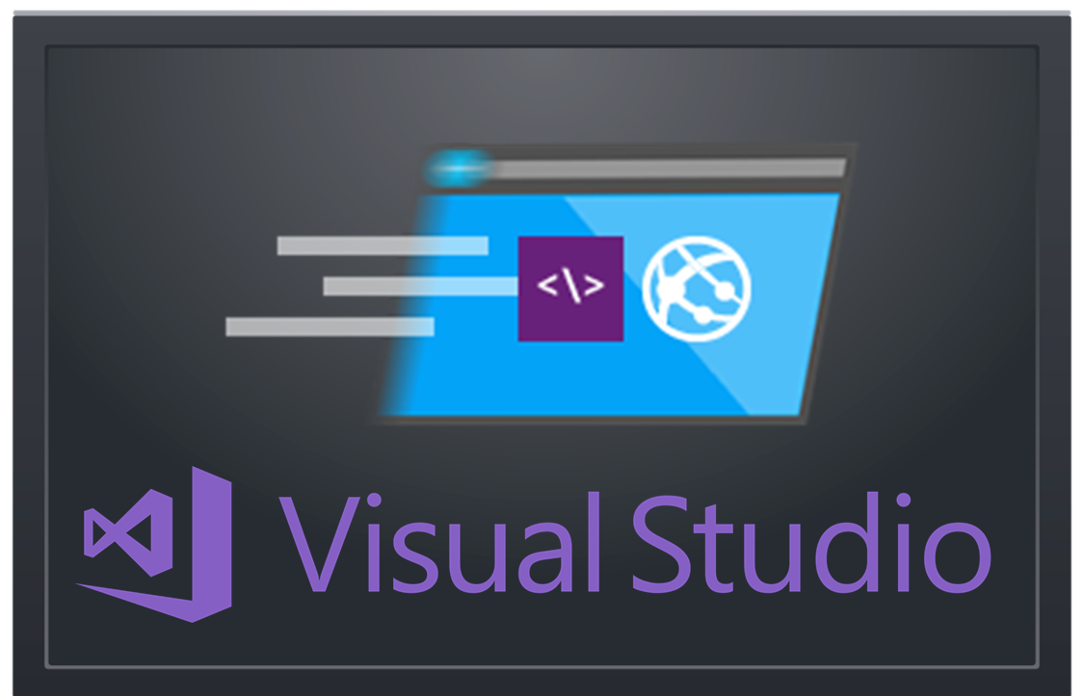
Creating an ASP.NET MVC App
Project Setup. What’s Inside?

Slide 17
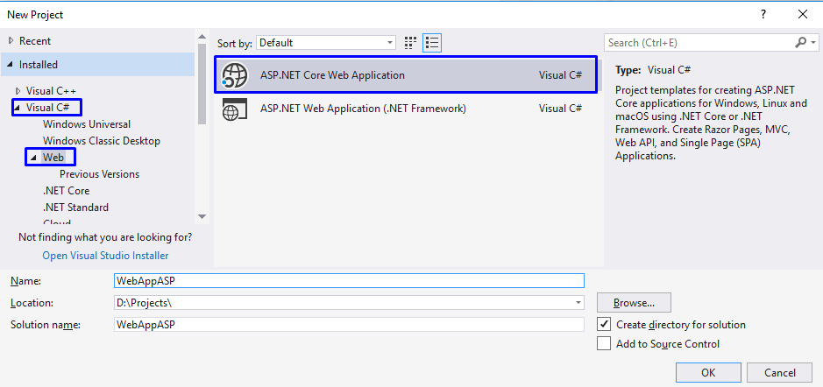
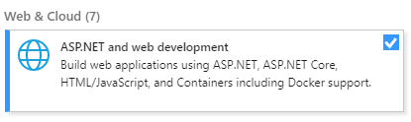
Create ASP.NET MVC App: Project Type
Install this in VS 2017!

Slide 18
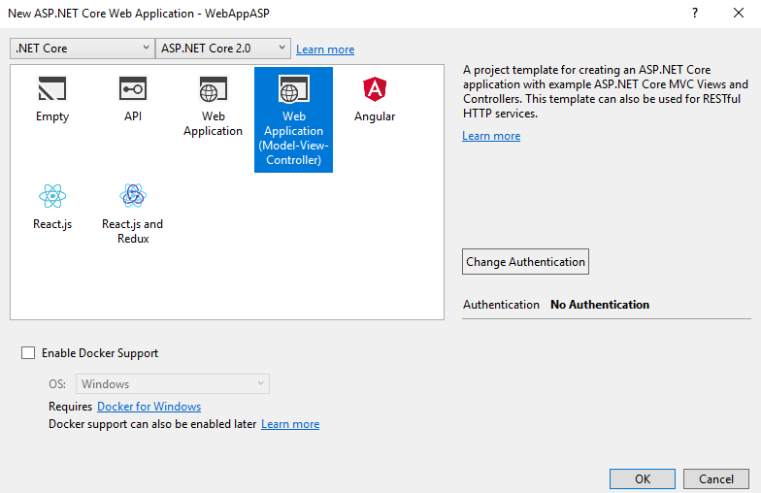
Create ASP.NET MVC App: Choose Template

Slide 19
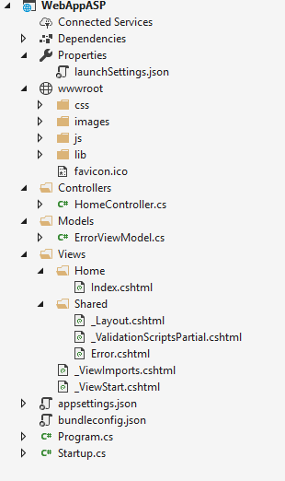
MVC App: What's Inside?
Static files: CSS styles images, fonts, …
NuGet packages
Controller classes holding actions
Models: EF classes + view models
Views: HTML templates for the pages
Shared views: layout for all pages + partial views
App start files

Slide 20
Controllers
MVC controllers hold logic to process user actions
The URL /Home/About invokes HomeController → About()
\Controllers\HomeController.cs
public class HomeController : Controller
{
public ActionResult About()
{
ViewBag.Message = "Your application description page.";
return View();
}
}
Renders Views\Home\About.cshtml

Slide 21
Views
Views render the HTML code for the invoked action
ASP.NET MVC uses Razor view engine
Views combine HTML with C# code
\Views\Home\About.cshtml
@{
ViewBag.Title = "About";
}
<h2>@ViewBag.Title</h2>
<h3>@ViewBag.Message</h3>
<p>Use this area to provide additional information.</p>
@ { … } inserts C# code block
@Something prints a C# variable
Everything else is HTML code

Slide 22
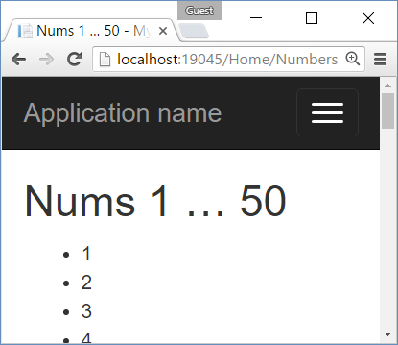
Example: Print the Numbers 1…50
Create an action /Home/Numbers + view Numbers.cshtml
HomeController.cs
\Views\Home\Numbers.cshtml
public class HomeController : Controller
{
public ActionResult Numbers()
{
return View();
}
}
@{ ViewBag.Title = "Nums 1 … 50"; }
<h2>@ViewBag.Title</h2>
<ul>
@for (int i = 1; i <= 50; i++)
{
<li>@i</li>
}
</ul>

Slide 23
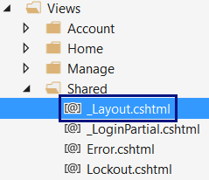
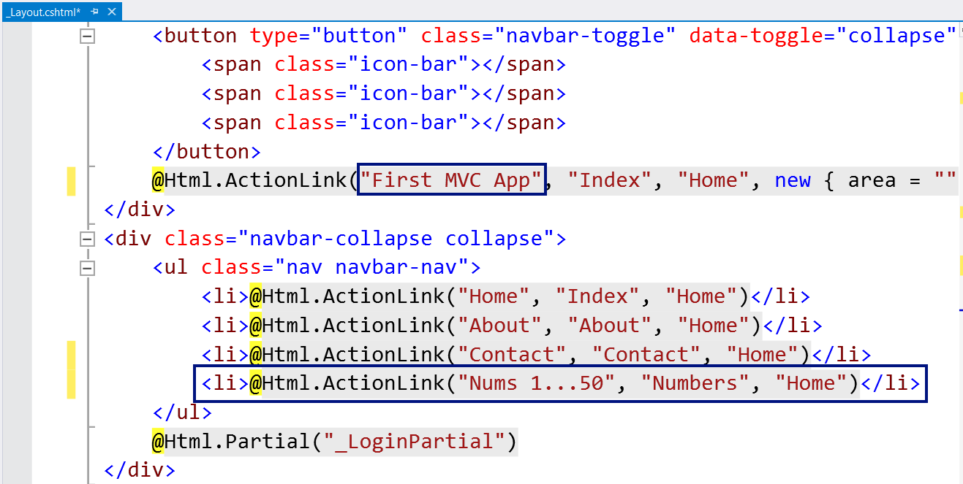
Changing the Page Layout

Slide 24
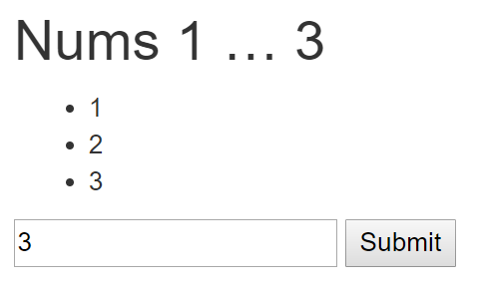
Example: Print the Numbers 1…N
HomeController.cs
\Views\Home\Numbers.cshtml
public class HomeController : Controller
{
public ActionResult Numbers(int count = 5)
{
ViewBag.Count = count;
return View();
}
}
@{ ViewBag.Title =
"Nums 1 … " + ViewBag.Count; }
<h2>@ViewBag.Title</h2>
<ul>
@for (int i = 1; i <= ViewBag.Count; i++) { <li>@i</li> }
</ul>
@using (Html.BeginForm())
{
@Html.TextBox("count");
<input type="submit" />
}

Slide 25
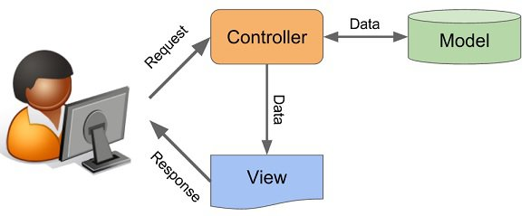
ASP.NET Controllers

Slide 26
ASP.NET Controllers
Controllers hold multiple actions on different routes
Route configuration is defined in RouteConfig.cs
Routes are automatically generated, based on RouteConfig
public class ArticleController : Controller
{
public IActionResult List(int Id)
{
// Code comes here …
}
}
Action parameters
Generated route: /Article/List/{id}

Slide 27
Controller Actions
Annotated with [Http{method}]
[HttpGet]
public IActionResult Index() {
return View();
}
[HttpPost]
public IActionResult Create()
{
…
}

Slide 28
Processing GET Requests
Create controller action, which processes a HTTP GET request:
Returns the view in Views/{controller}/{action}.cshtml
[HttpGet]
public ActionResult Index()
{
return View();
}

Slide 29
Processing POST Requests
Similar to [HttpGet], there is also an alias for method POST:
Similar attributes exist for all other types of request methods
[HttpPost]
public IActionResult Register()
{
…
}

Slide 30
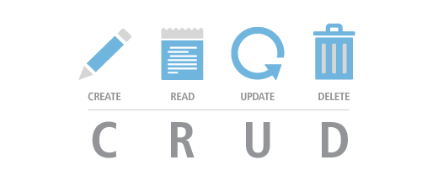
CRUD in ASP.NET MVC with EFC
Manipulating Databases in ASP.NET MVC

Slide 31
Define the Data Models (EF Entities)
Create a class /Models/Task.cs
Task.cs
public class Task
{
public int Id { get; set; }
[Required]
public string Title { get; set; }
}

Slide 32
Define the Data Models (EF Entities)
Create the DbContext class /Models/Task.cs
TaskDbContext.cs
public class TaskDbContext : DbContext
{
public DbSet<Task> Tasks { get; set; }
}

Slide 33
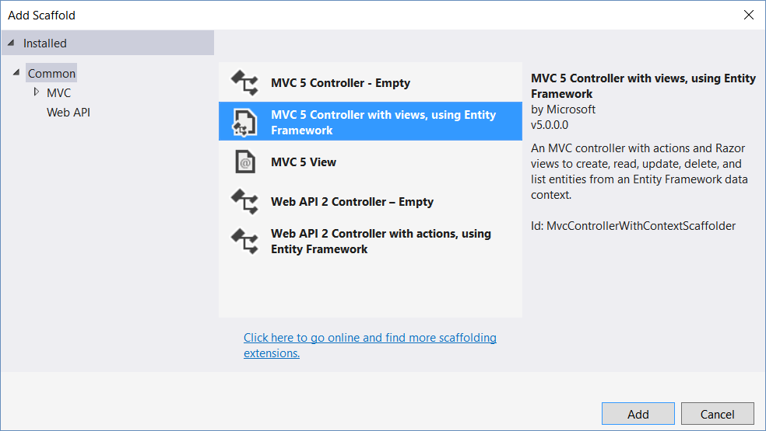
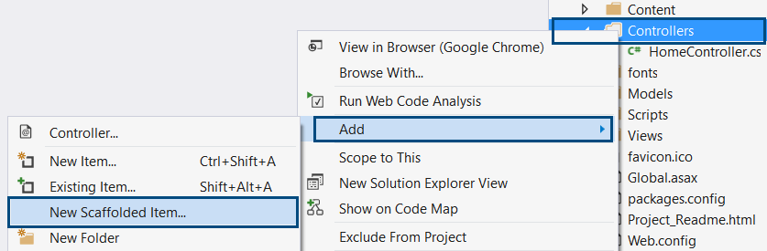
Implementing CRUD Operations

Slide 34
CRUD: Creating Entities – Controller
Adding new entry to database:
[HttpPost]
public IActionResult CreateArticle(string title, string content)
{
var article = new Article(title, content);
using (var db = new BlogDbContext())
{
db.articles.Add(article);
db.SaveChanges();
}
return RedirectToAction("Index", "Home");
}
Action name
Controller name

Slide 35
CRUD: Reading Entities – Controller
We can find a single element by ID, using DbContext.Find()
Generated route: “/Article/ArticleDetails/2”
[HttpGet]
public IActionResult ArticleDetails(int id)
{
using (var db = new BlogDbContext())
{
var article = db.Articles.Find(id);
return View(article);
}
}
Pass model to the view

Slide 36
CRUD: Reading Entities – Controllers (2)
We can retrieve an entire collection, using the DbContext:
Generated route: “/Article/ListArticles/”
[HttpGet]
public IActionResult ListArticles()
{
using (var db = new BlogDbContext())
{
var articles = db.Articles.ToList();
return View(articles);
}
}

Slide 37
CRUD: Reading Entities – Controllers (3)
We can use LINQ on DbContext, just like a normal collection
[HttpGet]
public IActionResult ArticlesByAuthor(int authorId)
{
using (var db = new BlogDbContext())
{
var articlesByAuthor = db.Articles
.Where(article => article.Author.Id == authorId)
.ToList();
return View(articlesByAuthor);
}
}

Slide 38
CRUD: Updating Entities
Editing existing entry in database:
[HttpPost]
public ActionResult Edit(int id, string title, string content)
{
using (var db = new BlogDbContext())
{
var article = db.Articles.Find(id);
article.Title = title;
article.Content = content;
db.SaveChanges();
}
return RedirectToAction("Index", "Home");
}

Slide 39
CRUD: Deleting Entities
Editing existing entry in database:
[HttpPost]
public IActionResult Delete(int id)
{
using (var db = new BlogDbContext())
{
var article = db.Articles.Find(id);
db.Articles.Remove(article);
db.SaveChanges();
}
return RedirectToAction("Index", "Home");
}

Slide 40
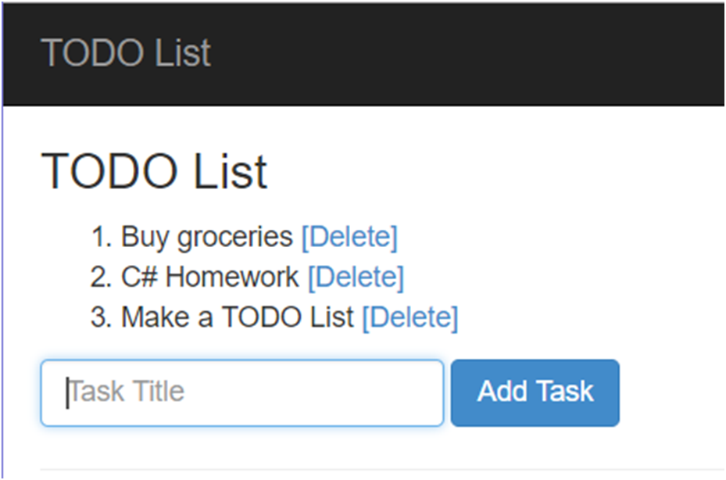
Problem: TODO List
Write an ASP.NET MVC app, which works like a TODO List:
Supports adding and deleting items

Slide 41
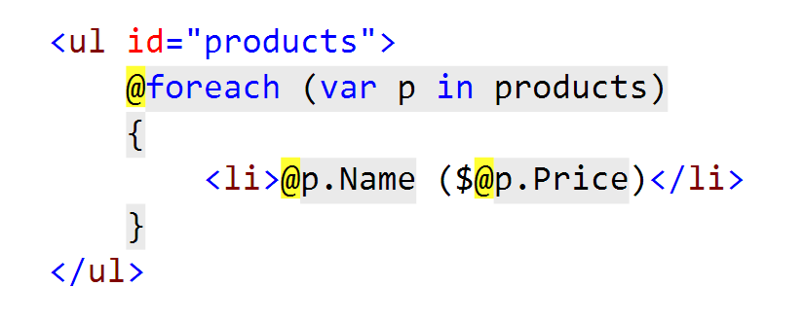
Razor View Engine
What is it? How do I use it?

Slide 42
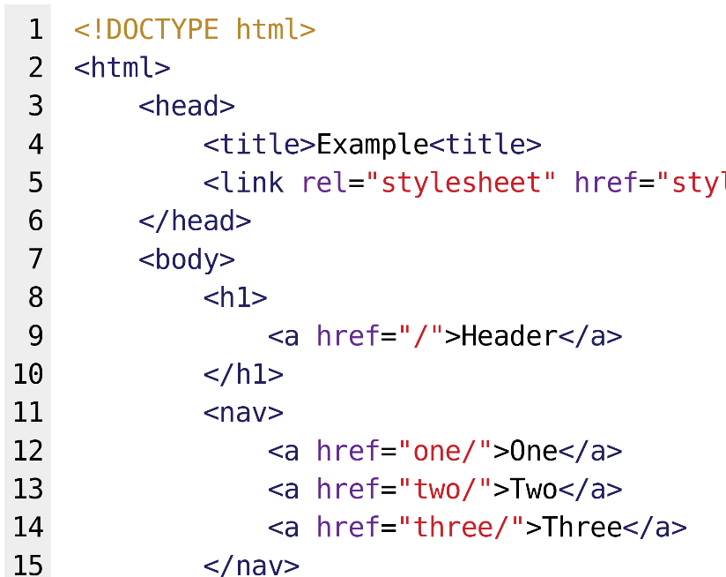

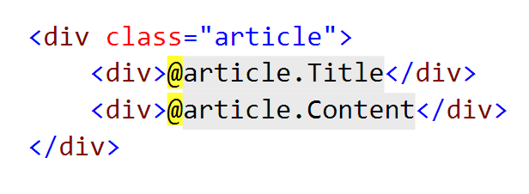
What is Razor?
Simple-syntax view engine
Code-focused templating approach
Easy transition between HTML and code
Examples: combining HTML and C#:

Slide 43
Razor View Engine: Example
HTML mixed with C# code (@ switches to C#):
<div class="row">
@foreach(var article in Model)
{
<article>
<h2>@article.Title</h2>
<p>@article.Content</p>
<small>--@article.Author.FullName</small>
</article>
}
</div>
C# foreach
C# code
HTML
Syntax
C# code

Slide 44
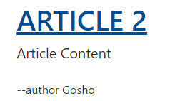
HTML Helpers: Example
We can use HTML helpers in Razor to generate HTML:
@Html.ActionLink(
article.Title,
"Details",
"Article",
new {
id = article.Id
},
new {
@class = "text-uppercase"
}
)
Link text
<a class="text-uppercase"
href="/Article/Details/2">
Article 2
</a>
HTML Result
Action
Controller
Controller Route Values
HTML Attributes

Slide 45
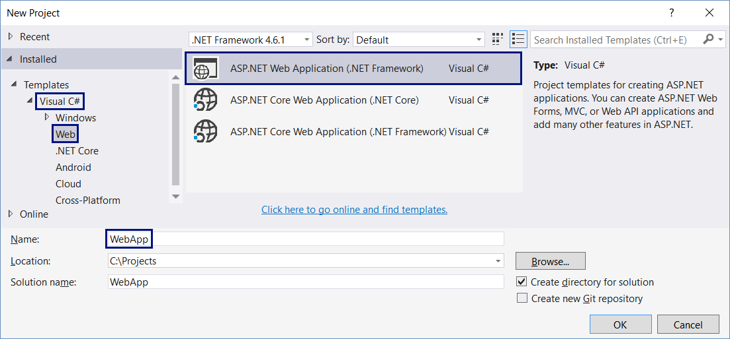
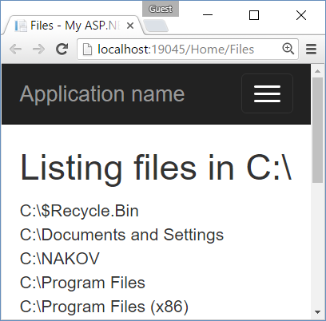
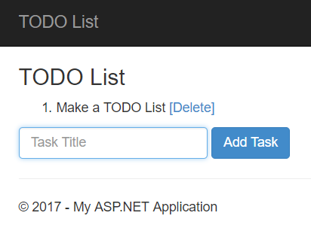
Creating Simple ASP.NET MVC Apps
Live Exercises in Class (Lab)

Slide 46

Summary
ASP.NET MVC is powerful Web development platform
Views render HTML code
Controllers process HTTP GET / POST actions
Great integration with databases and EF Core
VS generates CRUD operations by existing model
@foreach (var item in @Model)
{ <li>@item</li> }
public ActionResult Index()
{ return this.View(GetAllItems()); }

Slide 47






SoftUni Diamond Partners

Slide 48






SoftUni Diamond Partners

Slide 49







CSharp ASP.NET MVC Overview
https://softuni.bg/courses/csharp-web-development-basics

Slide 50
License
This course (slides, examples, demos, videos, homework, etc.) is licensed under the "Creative Commons Attribution-NonCommercial-ShareAlike 4.0 International" license

Slide 51





Trainings @ Software University (SoftUni)
Software University – High-Quality Education, Profession and Job for Software Developers
softuni.bg
Software University Foundation
http://softuni.foundation/
Software University @ Facebook
facebook.com/SoftwareUniversity
Software University Forums
forum.softuni.bg

